Slide 1






Re-architecting End-host Networking with CXL: Coherence, Memory, and Offloading
¹Houxiang Ji, ²Yifan Yuan, ¹Yang Zhou, ³Ipoom Jeong, ⁴Ren Wang,
¹Saksham Agarwal, ¹Nam Sung Kim
¹University of Illinois Urbana-Champaign, ²Meta, ³Yonsei University, ⁴Intel Corp.
Notes:
Thanks for the introduction. Hi everyone, today I will introduce our recent work, Re-architecting End-host Networking with CXL from three aspects: Coherence, Memory, and Offloading.

Slide 2






End-host Networking
Software
PCIe
>100 Gbps
Hardware
CPU
Can PCIe keep pace with rising network line rates?
Notes:
In the traditional end-host networking, PCIe is the de facto standard to connect NIC and host CPU. [CLICK]
During the past decade, inter-host network has advanced rapidly. To accommodate it, the NIC’s bandwidth has increased to 100Gbps and more. [CLICK]
Meanwhile, on the host side, there has been SW optimizations like DPDK for efficient processing. [CLICK]
More CPU cores are allocated to networking functions. [CLICK]
Our question is Can PCIe still keep pace with rising network line rates while PCIe has widen bandwidth across generations.

Slide 3

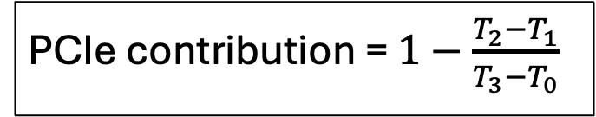
PCIe Latency Contribution
PCIe contribution = $1−\frac{T_{2}−T_{1}}{T_{3}−T_{0}}$
DPDK-based loopback test
T₃
Tx
CPU
Mem.
PCIe
T₂
Rx
T₁
T₀
PCIe contribution can be up to 57%
Notes:
To quantify the PCIe’s contribution to the end-host networking, we conduct a DPDK-based loopback test. [CLICK]
When a packet comes in, we timestamp it when arriving at the NIC, shown as T0 [CLICK].
The packet is transferred to host memory and becomes available to host at T1 [CLICK].
CPU simply copies the packet from Rx packet buffer to Tx packet buffer and T2 refers to the time CPU initiates the Tx packet transfer [CLICK].
Finally we record the time when Tx packet arrives at the NIC as T3.
The PCIe contribution is calculated as the equation shows, which isolates the overhead caused by CPU. [CLICK]
Our evaluation shows that PCIe contribution can be up to 57%, which becomes a bottleneck of the whole datapath.

Slide 4



Involved PCIe Operations
Take Tx datapath as an example
MMIO
CPU
Mem.
DMA
1
Desc.
4
DMA
Any faster and more efficient alternatives?
MMIO and DMA are the two major PCIe operations.
Notes:
We would ask why PCIe takes a such high portion in the datapath. Let’s take Tx datapath as an example and look closer to the flow. [CLICK]
To transfer a packet, the host CPU prepares the packet and the descriptor which contains the address of the packet. [CLICK]
Then host CPU updates the doorbell register through MMIO. [CLICK]
After being notified of the existence of new packet, NIC first DMA reads the descriptor [CLICK] and then DMA reads the packet based on the address in the descriptor [CLICK]
We can see that MMIO and DMA are the two major PCIe operations involved in the path [CLICK]
Since the PCIe becomes the bottleneck and MMIO and DMA are the two major PCIe operations, we wonder is there any faster and more efficient alternatives to alleviate the PCIe bottleneck

Slide 5

Our Answer: Compute Express Link (CXL)
Open standard industry-supported interconnect
Three protocols
CXL.io (interface initialization)
CXL.cache (cache coherence)
CXL.mem (memory expander)
Our focus
Type-1
CXL.io + CXL.cache
Type-2
CXL.io + CXL.cache + CXL.mem
Type-3
CXL.io + CXL.mem
Type-1
CXL.io + CXL.cache
Type-2
CXL.io + CXL.cache + CXL.mem
Offering coherent D2H and H2D memory access
Notes:
Our answer is Compute Express Link makes it possible. CXL is the open standard industry-supported interconnect with three protocols: …. [CLICK]
There are three types of CXL devices based on the supported protocols. [CLICK]
Our focus is the first two type which both supports CXL.cache and Type-2 device also supports CXL.mem. [CLICK]
The two protocols offer …

Slide 6
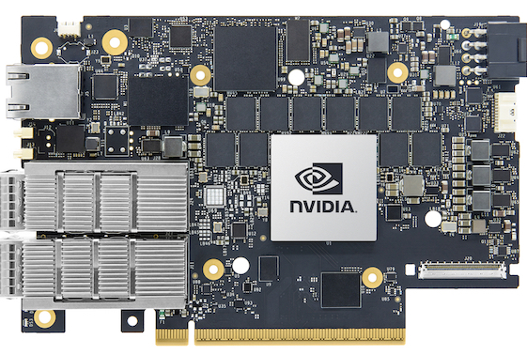
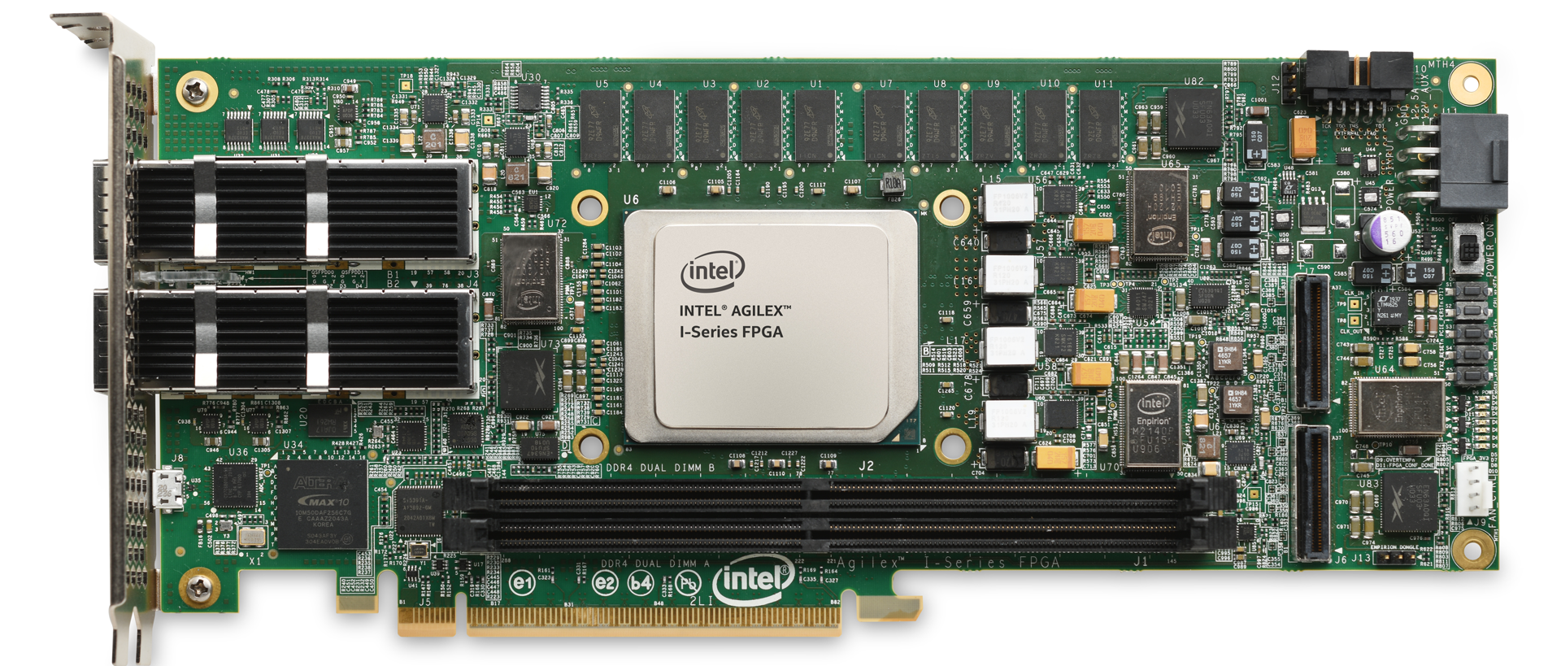
PCIe vs. CXL
Latency of PCIe and CXL operations
Datapath operation | PCIe operation | CXL operation
Rx packet transfer | D2H DMA write | CXL.cache D2H write
Tx packet/descriptor transfer | D2H DMA read | CXL.cache D2H read
NVIDIA BF-3
Intel Agliex-7
Notes:
We quantitively compares the PCIe-based and CXL-based operation to accomplish the datapath operations. [CLICK]
For example, for Rx packet transfer, PCIe uses … and the CXL counterpart is … [CLICK]
We use the NVIDIA BF-3 as the PCIe device and Intel Agliex-7 with hardcoded CXL IP as the CXL device.

Slide 7

PCIe vs. CXL cont.
Reduce by 81%!
Reduce by 69%!
Significant latency reduction from PCIe to CXL!
More analysis in the paper
Notes:
We demonstrate the packet transfer latency across multiple packet sizes ranging from 64B to 9K. [CLICK]
Looking at the 64-B packet, we can see the CXL-rd is 89% lower [CLICK] and CXL-write is 69% lower than DMA-write. [CLICK]
We can clearly see the significant latency reduction from PCIe to CXL. Reasons are 1. remove DMA setup overhead and 2. CXL optimized link/transaction layer. More analysis is provided in paper.

Slide 8
Coherence: Type-1 CXL-NIC
Host-NIC datapath by faster CXL.cache requests
Notes:
On the left hand, we show a typical structure of CXL Type-1 device, consisting of two main parts: …. [CLICK]
We implement several components to accomplish the datapath [CLICK]
Network interface receive and send packets through the ethernet [CLICK]
DMU is responsible for the descriptor reading, update and relevant operations. [CLICK]
PFU handles the packet transfer [CLICK] We leave the CSR/MMIO space to let CPU configure CXL-NIC via CXL.io.[CLICK]
Host-NIC datapath is now accomplished totally by faster CXL.cache requests.

Slide 9
Coherence: Type-1 CXL-NIC
Host-NIC datapath by faster CXL.cache requests
Notes:
On the left hand, we show a typical structure of CXL Type-1 device, consisting of two main parts: …. [CLICK]
We implement several components to accomplish the datapath [CLICK]
Network interface receive and send packets through the ethernet [CLICK]
DMU is responsible for the descriptor reading, update and relevant operations. [CLICK]
PFU handles the packet transfer [CLICK] We leave the CSR/MMIO space to let CPU configure CXL-NIC via CXL.io.[CLICK]
Host-NIC datapath is now accomplished totally by faster CXL.cache requests.

Slide 10
Coherence: Type-1 CXL-NIC
Device Cache Line State Control - Unique in CXL
Non-cacheable (NC)
Cacheable-shared (CS)
Cacheable-owned (CO)
Non-cacheable Push (NCP)
CXL.cache provides more!
Notes:
In addition to accomplish all the operations with CXL.cache requests, CXL.cache can provide more! [CLICK]
One unique feature is Device Cache Line State Control with four types ….
NC does not store data copy in device cache. CS and CO store the copy in shared state and owned state. NCP is the most interesting one. Device can push data from device into host LLC actively.

Slide 11
Coherence: Type-1 CXL-NIC
Example usage of CO read
Host
Mem.
Dev.
Cache
Host
Mem.
Dev.
Cache
CXL-NIC
CXL-NIC
N
N
N
N
N
…
invalidation
N
N
N+1
N+1
N
update
N
update
N+1
N+1
NC-based polling
CO-based polling
More CXL-specific optimizations in the paper
Notes:
Here is one example to exploit the benefits of this unique capability. For example, here host would like to signal a new packet by increasing the index.
NC-based polling is similar to the polling using non-coherent requests like DMA or MMIO. [CLICK]
CXL-NIC continuously poll on the data [CLICK]
When host updates the data, CXL can only know it at the next poll. [CLICK]
In contrast, first CO request brings the data into device cache, and the following polling request hit in the device cache. [CLICK]
When host updates the data, there is one invalidation signal sent to revoke the cache line in device cache. [CLICK]
The next CO poll request find the data stale and read from host memory directly. [CLICK]
With CO, we can achieve a ‘interrupt’-like polling method to get the new data quickly while we saves the CXL bandwidth consumed by the polling request.
More opt in paper.

Slide 12
Memory: Type-2 CXL-NIC
Introduce coherent on-NIC memory
Abundant on-NIC memory – Scalability
Exposed to host OS – Transparency
Accessibly by ld/st, 5.6x/4.5x faster than MMIO – Efficiency
Offering flexible networking data memory layout
Notes:
CXL Type-2 device introduces coherent on-NIC memory, offered by CXL.mem. [CLICK]
[CLICK] among bullets.
Considering the tolerable latency and easy access, the on-NIC memory offers ….

Slide 13
Memory: Type-2 CXL-NIC
Example: Tx Packet buffer in host (left) and NIC (right) memory
CPU (producer)
CXL (consumer)
CPU (producer)
CXL (consumer)
LLC
2
HMC
LLC
DMC
1
1
2
Core
PFU
Core
PFU
Mem.
Mem.
Mem.
Mem.
3
4
3
4
 | st
 | Host-Bias D2H NC/CS/CO-rd
 | st
 | Host-Bias D2D NC/CS/CO-rd
1
2
1
2
 | nt-st
 | Host/Device-Bias D2H NC/CS/CO-rd
 | nt-st
 | Host/Device-Bias D2D NC/CS/CO-rd
3
4
3
4
Various datapath and associated request selections to meet demand.
More combinations in the paper
Notes:
Here we take the placement of Tx packet buffer as an example.
On the left side, we allocate Tx packet buffer in host memory while in NIC memory on the right. [CLICK] There are two paths to transmit the packet. [CLICK] cache-based or memory-based
Let’s see them one by one.
First host CPU \st packet , update in host LLC [CLICK] then CXL-NIC can read it by host-bias D2D request [CLICK]
Or host CPU nt-st packet update memory directly [CLICK] then CXL-NIC can read the packet either in host-bias or device-bias mode [CLICK]
The device-bias is enabled since no cached copy existing. On the right hand, the datapath are similar, but we can note here for step 3 and 4 in two scenarios, their latency can differ

Slide 14

Memory: Type-2 CXL-NIC
CPU (consumer)
CXL (producer)
Intelligent usage of NC-P
CXL-NIC pushes the data into host LLC
CPU access hits in LLC
But “Leaky DMA” can happen
Our solution
Adaptative push-write gating: host CPU disable/enable NC-P at runtime
Post-push write-back: evict the cache line in host LLC after a while
LLC
DMC
2
1
Core
DMU
Mem.
Mem.
Notes:
NCP: CXL-NIC push [CLICK] data into host LLC and CPU can access [CLICK] form host LLC. [CLICK]
However, a “leaky dma” issue occurs [CLICK] as NCP may push data faster than the CPU consumption.
We propose two mitigations one is [CLICK] Adpative … and the other one is [CLICK] which

Slide 15

Offload: Network-App. Co-acceleration
Accelerate KVS application
Coherent on-NIC memory – hot data
Coherent access to host memory – cold data
Two paths
Fast local path
Slow remote path
CPU
CXL-NIC
Core
CXL
controller
Device Memory
LLC
DMU
PFU
Host
Memory
KVS request
handler
Network
I/F
Notes:
For the last perspective, we look at the offloading opportunity by co-accelerating the network and application.
In addition to the component for NIC capability, we integrate another component called KVS request handler to solve the request to key-value database. [CLICK]
We leverage the coherent on-NIC memory to store [CLICK] hot data. And host memory to store cold data [CLICK]. Remmeber that KVS handler can access host memory coherently. [CLICK]
We demonstrate two paths, fast local path, hit in hot data [CLICK] and slow remote path [CLICK]

Slide 16
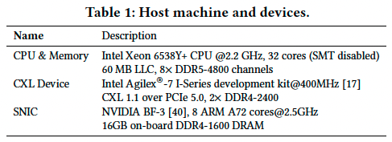
Evaluation
System setup
5th Gen Intel Xeon Scalable Processor
Intel Agilex-7 I-series, 400MHz
NVIDIA BF-3
Benchmarks
Loopback tests
KVS: read-only/write-intensive workloads
Notes:
Let’s look into some evaluation results of CXL-NIC.
We use a single-socket Intel 5th generation Xeon CPU, Intel Agliex-7 board for CXL device and an arm core-based SmartNIC, Nvidia Bluefield-3, as mentioned before.
We use both synthetic workloads for loopback test and a key-value store application with two various workloads.

Slide 17
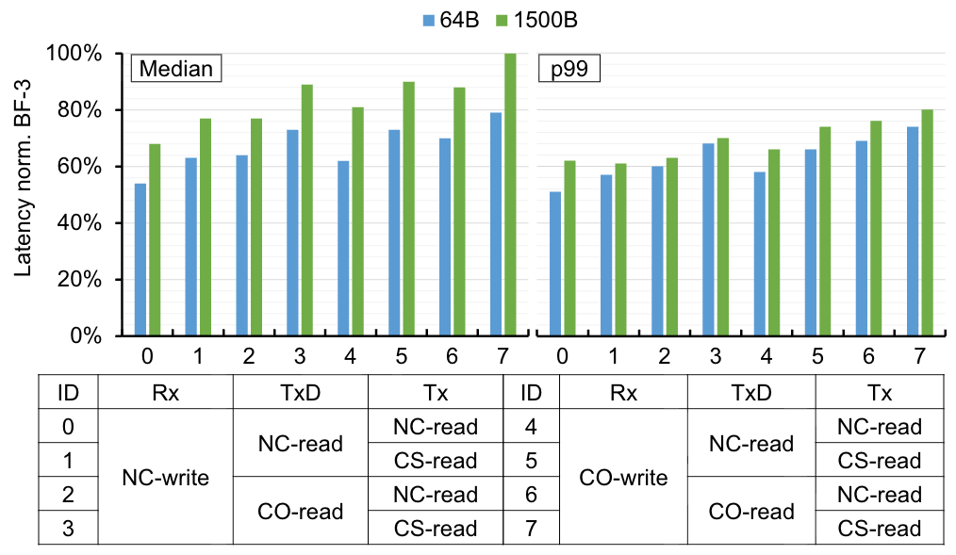
Type-1 CXL-NIC
Loopback tests with various request types
Eight representative selections
Rx packet transfer, Tx descriptor transfer and Tx packet transfer
Normalized to BF-3

Slide 18
Loopback test - Latency
Takeaway 1: CXL-NIC reduces median and p99 latency by 46% and 49%. Selections have notable effects on latency.

Slide 19
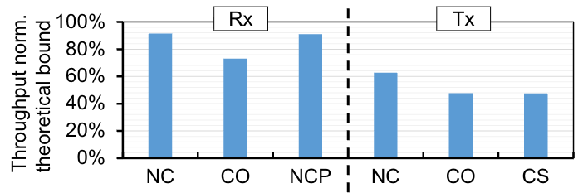
Lookback test - Throughput
Packet transfer by NC/CO/CS/NCP
Takeaway 2: NC/NCP-based packet transfer can utilize 90% of the CXL bandwidth. CO/CS is lower due to coherence state traffic.

Slide 20
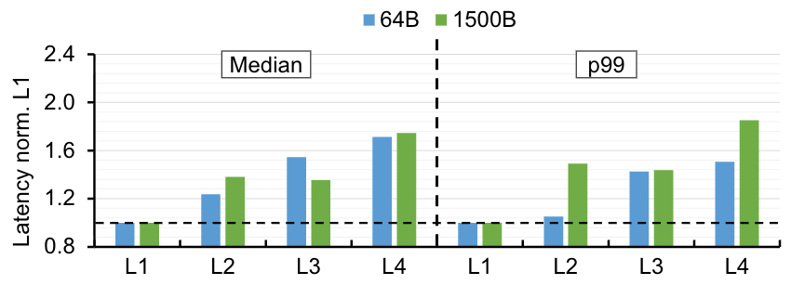
Type-2 CXL-NIC
Loopback tests with various memory layouts
Takeaway 3: Placing packet buffer in CXL memory may degrade performance, up to 71%.
Notes:
We examine the four layouts to place Rx and Tx packet buffers. Here we use NC requests by default. We can see that [takeaway].

Slide 21
Type-2 CXL-NIC
Compare w. CC-NIC^{[1]}
UPI-based, no explicit cache state control
Requires explicit buffer cleaning to remove packet on NIC
No active NCP to enable host LLC hit
Overlooks the hardware asymmetry
CXL-NIC achieves 37% lower latency than CC-NIC
[1] Schuh, Henry N., et al. "CC-NIC: a Cache-Coherent Interface to the NIC." Proceedings of the 29th ACM International Conference on Architectural Support for Programming Languages and Operating Systems, Volume 1. 2024.
Notes:
Compared to CC-NIC, another cutting-edge work based on coherent interconnect, UPI. [CLICK]
[CLICK] between bullets.

Slide 22
Network-App. Co-acceleration
Uniform Distribution
Zipfian 0.9 Distribution
Takeaway 4: CXL-NIC achieves 39% reduction in p99 latency. Current performance improvements are limited by FPGA frequency.
Notes:
Just takeaway.

Slide 23
Summary
Rearchitecting end-host networking with CXL
Identifying the ‘killer’ application for CXL.cache – end-host networking
Simplifying and accelerating host-NIC datapaths with coherence
Leveraging coherent on-NIC memory to reduce host memory pressure
Application-networking co-acceleration
Notes:
In summary, [CLICK] for each bullet.

Slide 24
Q & A

